Slide 1
Traffic Sign Classification Chandan Saha Mayank Ramakanth Vemula
ML Final Project

Slide 2
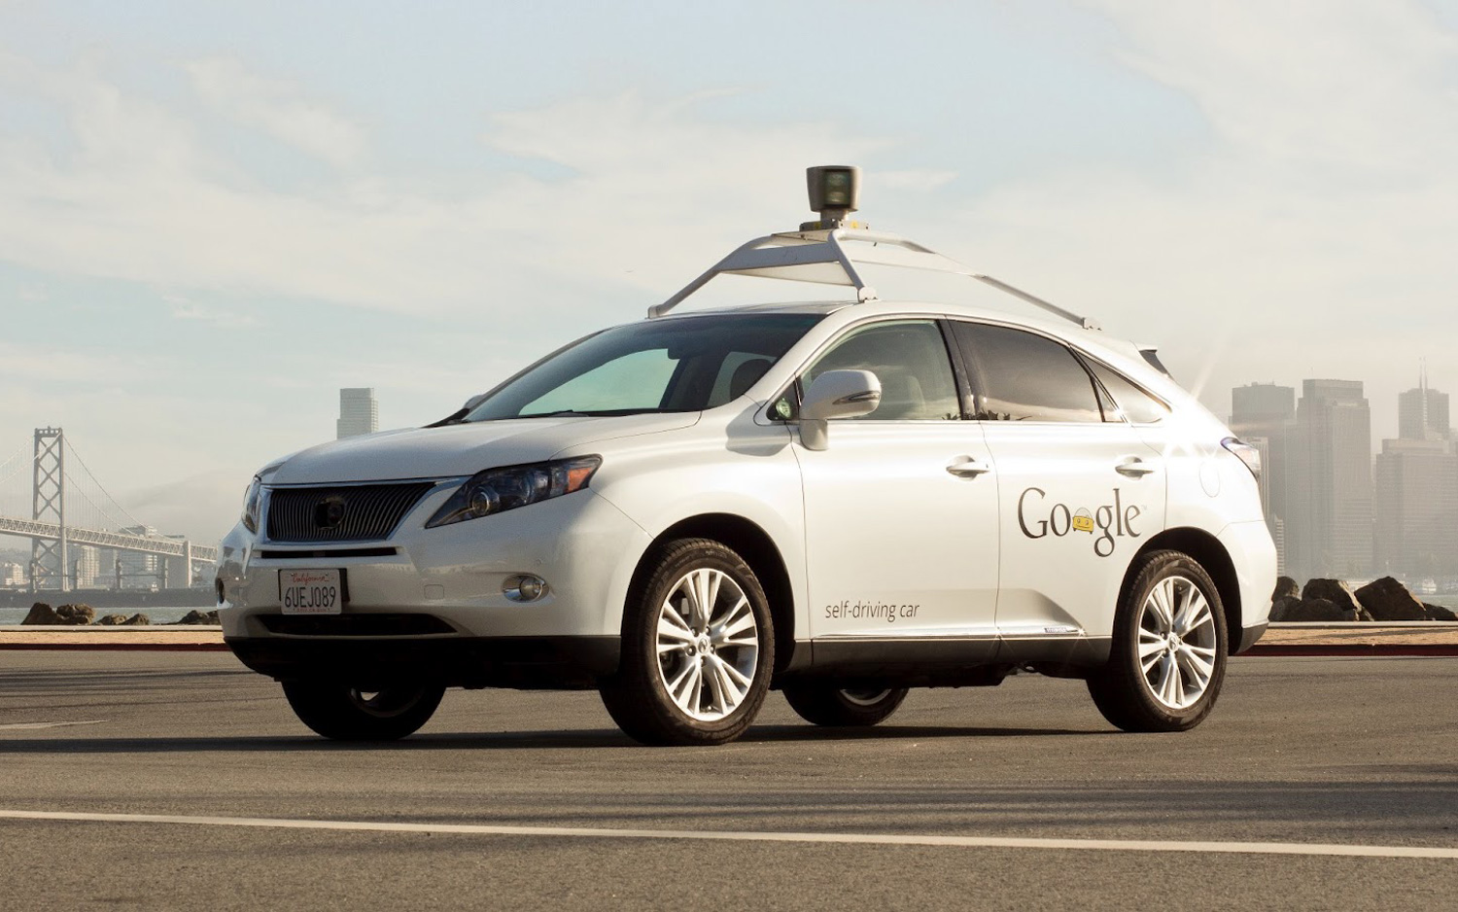
Introduction
We may soon see Autonomous vehicles in the not so distant future.
Traffic sign detection and classification is a very important aspect for such vehicles.
We mainly deal with the problem of classification
Several algorithms are available which provide a high degree of accuracy (LDA, SVM). But these take a long time to train and test.
Solution – Convolutional Neural Network (with GPU)

Slide 3
Data Sets
LISA (Laboratory for Intelligent & Safe Automobiles) Traffic Sign Dataset is a set of annotated images and videos containing traffic signs .
Dataset comprises of 6000 frames contain over 7000 signs
47 types of signals .
GTSRB – German Traffic Sign Dataset
Dataset comprised of 43 types of signals.
39,000 images in total.

Slide 4
Architecture
Input
Convolutional
Output
RELU
Max Pooling
FC
Dropout

Slide 5
Architecture
Filter
Number of Filters – 32
Size of Filter – 3 x 3
Slide – 1
Max Pooling
Size of Filter – 2x 2
Stride – 2
Activation Function - ReLU

Slide 6
Architecture
Input
Convolution
Activation (ReLU)
Convolution
Activation (ReLU)
MaxPooling
Convolution
Activation (ReLU)
Convolution
Activation (ReLU)
MaxPooling
Fully Connected Network
Classification

Slide 7
Experiment
Divide data into 80% for training and 20% for testing
Image Pre-processing
All images converted into grey scale .
Images resized to 32 * 32 pixels .
Convert images to pickle file.
Train the model for the Convolutional Neural Network using the pickle file.
Calculate accuracy of testing set.
We have used GPU to run all classification .

Slide 8
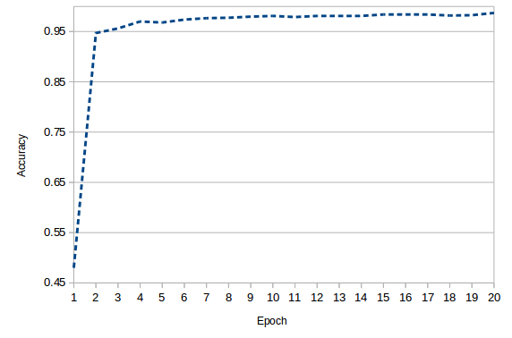
Result

Slide 9
Results
Benchmarking on GTSRB and LISA Data Set
Running on GPU(Nvidia GeForce 940) is 5x times faster than CPU
DataSet | No. of Classes | Accuracy | Test Time | Train Time (per epoch)
GTSRB | 43 | 99.31 % | 15.3 m.s | 210 s
GTSRB (GPU) | 43 | 99.31 % | 3.5 m.s | 45 s
LISA | 16 | 98.7% | 14.6 m.s | 33 s
LISA (GPU) | 16 | 98.7% | 3.5 m.s | 3 s

Slide 10
Comparison
Bodington, Dashiell, Eric Greenstein, and Matthew Hu. "Implementing Machine Learning Algorithms on GPUs for Real-Time Traffic Sign Classification."
 | Previous Results | Our Results
Time Taken | 4 m.s | 3.5 m.s
Accuracy (number of classes) | 98.75 (6) | 98.7 (16)

Slide 11
Further Improvements
Autonomous vehicles would mainly rely on detection. Can use segmentation to extract portions of images which may contain traffic signs and then use classification .

Slide 12
References
P Sermanet , Y LeCun . Traffic Sign Recognition with Multi-Scale Convolutional Networks .
J. Stallkamp , M. Schlipsing , J. Salmen , C. Igel . Man vs. Computer: Benchmarking Machine Learning Algorithms for Traffic Sign Recognition .
Traffic Sign Localization and Classification Methods: An Overview. Ivan Filkovic ́

Slide 13
Thank You

Slide 14
Back Up

Slide 15
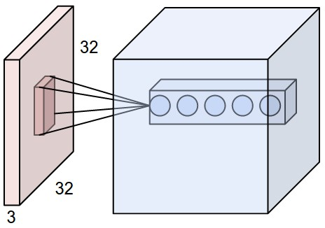
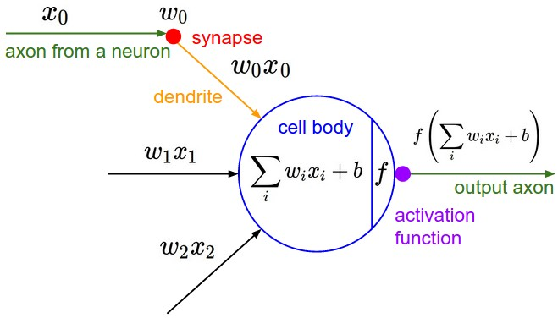
Convolutional Layer
Local Connectivity. When dealing with high-dimensional inputs such as images, as we saw above it is impractical to connect neurons to all neurons in the previous volume. Instead, we will connect each neuron to only a local region of the input volume.
The spatial extent of this connectivity is a hyperparameter called the receptive field of the neuron.
Parameter Sharing. Parameter sharing scheme is used in Convolutional Layers to control the number of parameters.
Backpropagation. The backward pass for a convolution operation (for both the data and the weights) is also a convolution (but with spatially-flipped filters).
Spatial arrangement. We have explained the connectivity of each neuron in the Conv Layer to the input volume, but we haven't yet discussed how many neurons there are in the output volume or how they are arranged. Three hyperparameters control the size of the output volume: the depth, stride and zero-padding.

Slide 16
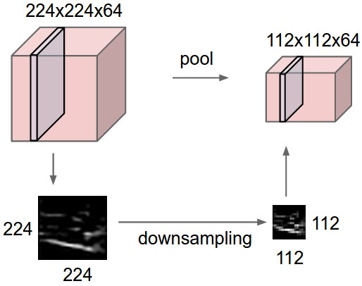
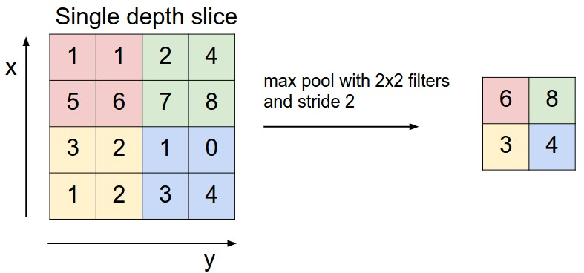
Pooling
It is common to periodically insert a Pooling layer in-between successive Conv layers in a ConvNet architecture. Its function is to progressively reduce the spatial size of the representation to reduce the amount of parameters and computation in the network, and hence to also control overfitting.
Why use stride of 1 in CONV? Smaller strides work better in practice. Additionally, as already mentioned stride 1 allows us to leave all spatial down-sampling to the POOL layers, with the CONV layers only transforming the input volume depth-wise.
Why use padding? In addition to the aforementioned benefit of keeping the spatial sizes constant after CONV, doing this actually improves performance. If the CONV layers were to not zero-pad the inputs and only perform valid convolutions, then the size of the volumes would reduce by a small amount after each CONV, and the information at the borders would be "washed away" too quickly.
Notes:
The conv layers should be using small filters (e.g. 3x3 or at most 5x5), using a stride of S=1S=1, and crucially, padding the input volume with zeros in such way that the conv layer does not alter the spatial dimensions of the input. That is, when F=3F=3, then using P=1P=1 will retain the original size of the input

Slide 17
Back Propagation
Backpropagation. Recall from the backpropagation chapter that the backward pass for a max(x, y) operation has a simple interpretation as only routing the gradient to the input that had the highest value in the forward pass. Hence, during the forward pass of a pooling layer it is common to keep track of the index of the max activation (sometimes also called the switches) so that gradient routing is efficient during backpropagation.
Recent developments.
Fractional Max-Pooling suggests a method for performing the pooling operation with filters smaller than 2x2. This is done by randomly generating pooling regions with a combination of 1x1, 1x2, 2x1 or 2x2 filters to tile the input activation map. The grids are generated randomly on each forward pass, and at test time the predictions can be averaged across several grids.
Striving for Simplicity: The All Convolutional Net proposes to discard the pooling layer in favor of architecture that only consists of repeated CONV layers. To reduce the size of the representation they suggest using larger stride in CONV layer once in a while.

Slide 18
Case Studies
LeNet. The first successful applications of Convolutional Networks were developed by Yann LeCun in 1990's. Of these, the best known is the LeNet architecture that was used to read zip codes, digits, etc.
AlexNet. The first work that popularized Convolutional Networks in Computer Vision was the AlexNet, developed by Alex Krizhevsky, Ilya Sutskever and Geoff Hinton. The AlexNet was submitted to the ImageNet ILSVRC challenge in 2012 and significantly outperformed the second runner-up (top 5 error of 16% compared to runner-up with 26% error). The Network had a similar architecture basic as LeNet, but was deeper, bigger, and featured Convolutional Layers stacked on top of each other (previously it was common to only have a single CONV layer immediately followed by a POOL layer).
ZF Net. The ILSVRC 2013 winner was a Convolutional Network from Matthew Zeiler and Rob Fergus. It became known as the ZFNet (short for Zeiler & Fergus Net). It was an improvement on AlexNet by tweaking the architecture hyperparameters, in particular by expanding the size of the middle convolutional layers.
GoogLeNet. The ILSVRC 2014 winner was a Convolutional Network from Szegedy et al. from Google. Its main contribution was the development of an Inception Module that dramatically reduced the number of parameters in the network (4M, compared to AlexNet with 60M). Additionally, this paper uses Average Pooling instead of Fully Connected layers at the top of the ConvNet, eliminating a large amount of parameters that do not seem to matter much.
VGGNet. The runner-up in ILSVRC 2014 was the network from Karen Simonyan and Andrew Zisserman that became known as the VGGNet. Its main contribution was in showing that the depth of the network is a critical component for good performance. Their final best network contains 16 CONV/FC layers and, appealingly, features an extremely homogeneous architecture that only performs 3x3 convolutions and 2x2 pooling from the beginning to the end. It was later found that despite its slightly weaker classification performance, the VGG ConvNet features outperform those of GoogLeNet in multiple transfer learning tasks. Hence, the VGG network is currently the most preferred choice in the community when extracting CNN features from images. In particular, their pretrained model is available for plug and play use in Caffe. A downside of the VGGNet is that it is more expensive to evaluate and uses a lot more memory and parameters (140M).
ResNet. Residual Network developed by Kaiming He et al. was the winner of ILSVRC 2015. It features an interesting architecture with special skip connections and features heavy use of batch normalization. The architecture is also missing fully connected layers at the end of the network. The reader is also referred to Kaiming's presentation (video, slides), and some recent experiments that reproduce these networks in Torch.

Slide 19
Normalization Layer
Many types of normalization layers have been proposed for use in ConvNet architectures, sometimes with the intentions of implementing inhibition schemes observed in the biological brain. However, these layers have recently fallen out of favor because in practice their contribution has been shown to be minimal, if any
Fully-connected layer
Neurons in a fully connected layer have full connections to all activations in the previous layer, as seen in regular Neural Networks. Their activations can hence be computed with a matrix multiplication followed by a bias offset. See the Neural Network section of the notes for more information.
Converting FC layers to CONV layers
It is worth noting that the only difference between FC and CONV layers is that the neurons in the CONV layer are connected only to a local region in the input, and that many of the neurons in a CONV volume share parameters. However, the neurons in both layers still compute dot products, so their functional form is identical. Therefore, it turns out that it's possible to convert between FC and CONV layers:

